Slide 1
Team Members & Roles
Riya Agrawal and Ayman Kazi - Front end
Vaishnavi Phophale , Tanishka Deshpande, Shreya Pawar - Research
Vaidehi Mahale - Model training and data preprocessing

Slide 2
Problem Statement
Yoga Pose Detection and Correction using Mediapipe and OpenCV2

Slide 3
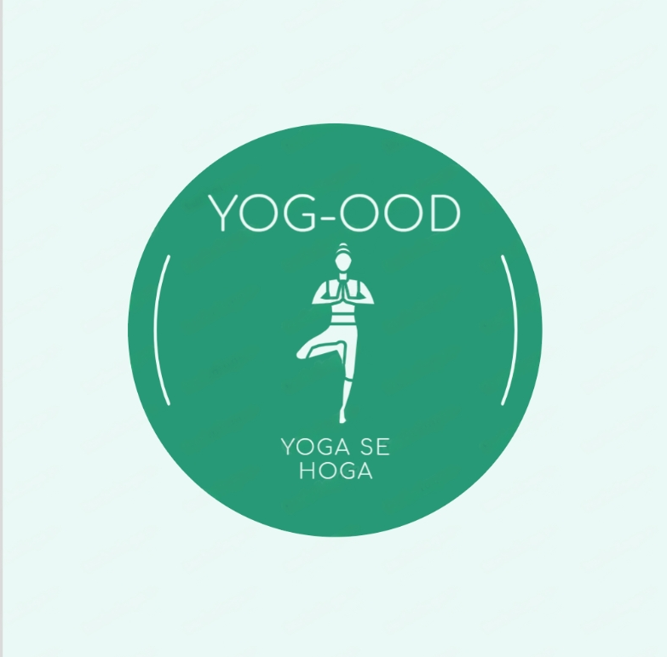
Yog-ood
Yoga se Hoga

Slide 4
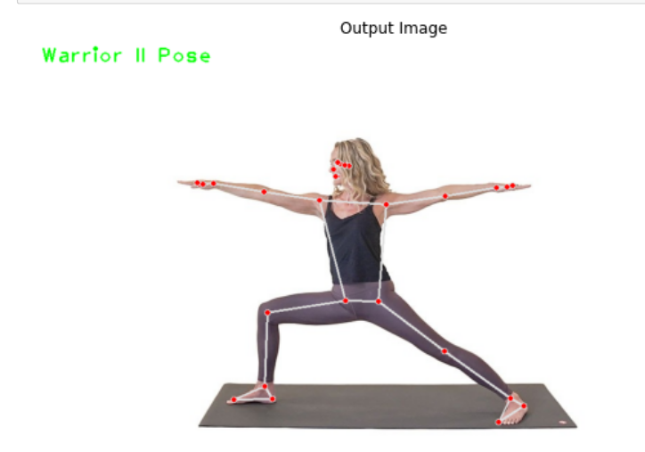
Solution
We have made a yoga detection and correction model that detects and corrects your yoga posture. This works both on images and real time videos

Slide 5
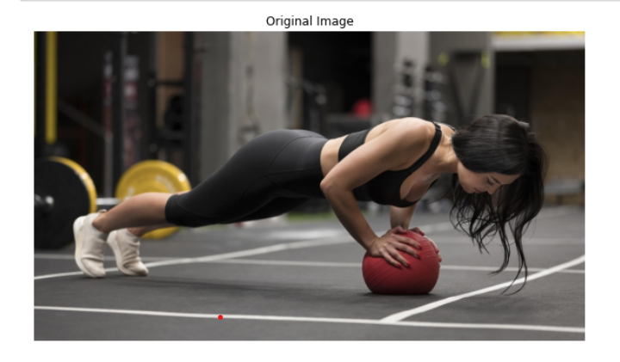
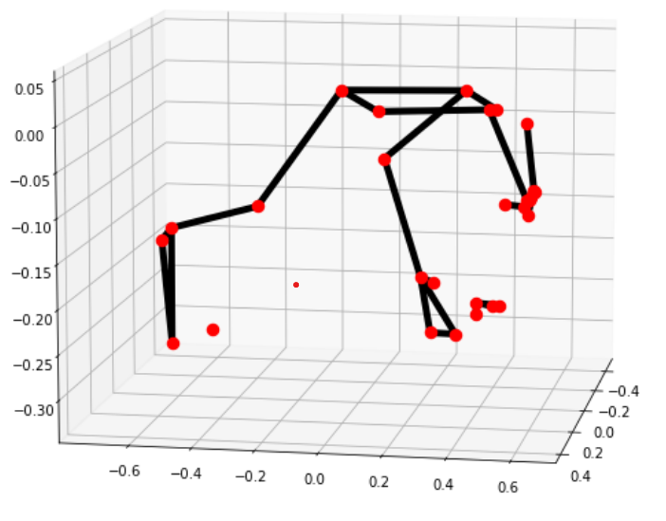
Wow factors
Takes in 3 D plots of the skeleton
Works on any normal office laptop
Gives you instructions on how to correct your posture
It works on images, videos and real-time data as well.

Slide 6
Let’s Jump into the Demo!
(exit presentation & showcase your project)

Slide 7
Learnings during the Hackathon
How to work with a team
How to train models and learn about mediapipe and opencv
How to formulate project idea and do project execution
How to make front end and do model deployment

